Slide 1
Improved Tracking of Workplace Injuries and Illness
Jim Shelton, CAS
Houston North Area Office

Slide 2
Improved Tracking of Workplace Injuries and Illness
Issued May 11 and published May 12, 2016 with an effective date of August 10, 2016 and phased in data submission beginning 2017
What does the rule cover
Who has to report
What has to be reported
Related issues:
Discrimination and OSHA citations
Post Incident Drug Testing
Incentive Programs

Slide 3
Why Collect the Data
OSHA will be able to better identify small and medium employers who report high overall injury/illness rates for referral to the OSHCON program
Allow OSHA to identify emerging hazards and support a response and reach out to employers whose workplaces might include those hazards
Allow OSHA to more effectively target enforcement resources to establishments with high rates or numbers of injuries and illnesses and better evaluate its interventions
Data will be used for targeting inspections and emphasis programs
Enable OSHA to evaluate the impact of government injury prevention activities

Slide 4
Why Publicize the Data
Publicizing the data is expected to provide benefits for example:
Encourage employers to improve workplace safety and health to support their reputations as good places to work or to do business with
Assist employers who want to bench mark to improve safety and health performance
Allows employees to compare their workplace to the safest workplaces in their industries
Improve the workings of the labor market by providing information to job seekers which would encourage employers to abate hazards to attract more desirable employees

Slide 5
Why Publicize the Data
Data will permit investors to identify investment opportunities in firms with low injury and illness rates
Data will allow members of the public to be able to make more informed decisions about current and potential places with which to conduct business
In construction projects preference is often given to subcontractors with lower injury and illness rates and above certain rates are not eligible for the contract work. Publication will allow corporate and individual customers to consider these rates in the selection of venders and contractors
Increase the accuracy of recorded data
There’s more additional expected benefits discussed in the FR…

Slide 6
How would the Data be Collected
The data will be electronically submitted or manually entered
Maybe MS Excel, XML, or csv…
Its expected a help desk will be established to assist with data collection and submission
Employers with technical difficulties would have multiple chances to submit the data before a citation is issued for non-response

Slide 7
OSHA Form 300

Slide 8
OSHA Form 301

Slide 9
OSHA Form 300A

Slide 10
Who Keeps Injury and Illness Records
Under the 1904 Recordkeeping standard establishments with 10 or less workers or those in a low hazard industry (regardless of size) do not normally have to maintain the OSHA 300, 301, and 300A injury and illness forms
The list of low hazard industries was updated in 2014 as part of the new reporting requirements relating to hospitalizations, amputations, and loss of an eye. At that time some industries were added to the list e.g. New Car Dealers and others dropped off the list e.g. Death Care Services
The determination of what was a ‘low hazard industry’ (in eligible industry sectors) were those with a DART rate at or below 75% (1.5) of the three year average DART rate for private industry (2.0)

Slide 11
The new reporting requirements do not change the basic requirement of who keeps records under 1904 The ‘affected’ establishments already keep records…
So what does the new ‘Improved Tracking of Workplace Injuries and Illnesses’ mean?

Slide 12
Who Submits Injury and Illness Records
What is an establishment…
… a single physical location where business is conducted or where services or industrial operations are performed. For activities where employees do not work at a single physical location, such as construction; transportation; communications, electric, gas and sanitary services; and similar operations, the establishment is represented by main or branch offices, terminals, stations, etc. that either supervise such activities or are the base from which personnel carry out these activities
What about size of a company
That’s determined by the size of the whole company for the small employer exemption in RK but for the electronic reporting it refers to the size of the establishment

Slide 13
Who Submits Injury and Illness Records
Reporting Establishments with 250+ Employees
Construction Sites > 1 Year
(250+ or 20-249)
Reporting Establishments with 20-249 Employees
Construction/ Establishments w Short Term Sites
(250+ or 20-249)
ST Work sites
ST Work sites
ST Work sites
Every employee is tied to one establishment…

Slide 14
Who Submits Injury and Illness Records
Establishments with 20 to 249 employees in designated high hazard Industries will be required to electronically submit their OSHA 300A each year
High hazard industries were those with a DART rate of 2.0 or greater (e.g. above the National DART three year average for private industry BLS years 2011, 2012, 2013)
Appendix A to Subpart E of Part 1904—Designated Industries for § 1904.41(a)(2) Annual Electronic Submission of OSHA Form 300A Summary of Work-Related Injuries and Illnesses by Establishments…

Slide 15
The Designated Industries…
NAICS | Industry
11 | Agriculture, forestry, fishing and hunting
22 | Utilities
23 | Construction
31-33 | Manufacturing
42 | Wholesale trade
4413 | Automotive parts, accessories, and tire stores
4421 | Furniture stores
4422 | Home furnishings stores
4441 | Building material and supplies dealers
4442 | Lawn and garden equipment and supplies stores
4451 | Grocery stores

Slide 16
The Designated Industries…
NAICS | Industry
4452 | Specialty food stores
4521 | Department stores
4529 | Other general merchandise stores
4533 | Used merchandise stores
4542 | Vending machine operators
4543 | Direct selling establishments
4811 | Scheduled air transportation
4841 | General freight trucking
4842 | Specialized freight trucking
4851 | Urban transit systems
4852 | Interurban and rural bus transportation

Slide 17
The Designated Industries…
NAICS | Industry
4853 | Taxi and limousine service
4854 | School and employee bus transportation
4855 | Charter bus industry
4859 | Other transit and ground passenger transportation
4871 | Scenic and sightseeing transportation, land
4881 | Support activities for air transportation
4882 | Support activities for rail transportation
4883 | Support activities for water transportation
4884 | Support activities for road transportation
4889 | Other support activities for transportation
4911 | Postal service

Slide 18
The Designated Industries…
NAICS | Industry
4921 | Couriers and express delivery services
4922 | Local messengers and local delivery
4931 | Warehousing and storage
5152 | Cable and other subscription programming
5311 | Lessors of real estate
5321 | Automotive equipment rental and leasing
5322 | Consumer goods rental
5323 | General rental centers
5617 | Services to buildings and dwellings
5621 | Waste collection
5622 | Waste treatment and disposal

Slide 19
The Designated Industries…
NAICS | Industry
5629 | Remediation and other waste management services
6219 | Other ambulatory health care services
6221 | General medical and surgical hospitals
6222 | Psychiatric and substance abuse hospitals
6223 | Specialty (except psychiatric and substance abuse) hospitals
6231 | Nursing care facilities
6232 | Residential mental retardation, mental health and substance abuse facilities
6233 | Community care facilities for the elderly
6239 | Other residential care facilities
6242 | Community food and housing, and emergency and other relief services
6243 | Vocational rehabilitation services

Slide 20
The Designated Industries…
NAICS | Industry
7111 | Performing arts companies
7112 | Spectator sports
7121 | Museums, historical sites, and similar institutions
7131 | Amusement parks and arcades
7132 | Gambling industries
7211 | Traveler accommodation
7212 | RV (recreational vehicle) parks and recreational camps
7213 | Rooming and boarding houses
7223 | Special food services
8113 | Commercial and industrial machinery and equipment (except automotive and electronic) repair and maintenance
8123 | Dry-cleaning and laundry services

Slide 21
Who Submits Injury and Illness Records
Establishments with 250 employees will be required to electronically submit their OSHA 300, 301, and 300A annually
Not related to whether they are a ‘high hazard’ or a ‘low hazard’ industry. It’s size based…

Slide 22
Who Submits Injury and Illness Records
There will be a phase in period starting in January 2017…
Beginning 2019 the submission deadline changes from July 1st to March 2nd
Submission Year | Establishments With 250 or More Employees | Establishments With 20-249 Employees | Submission Deadline
2017 | Form 300A | Form 300A | July 1, 2017
2018 | Form 300A, 300, 301 | Form 300A | July 1, 2018
2019 | Form 300A, 300, 301 | Form 300A | March 2, 2019

Slide 23
Publicly Available
Some of the submitted information will be available for public viewing through the OSHA website
Software will be used to scrub any PII that may be entered into a publically available field

Slide 24
Not Collected Collected Public Access Collected No Public Access

Slide 25
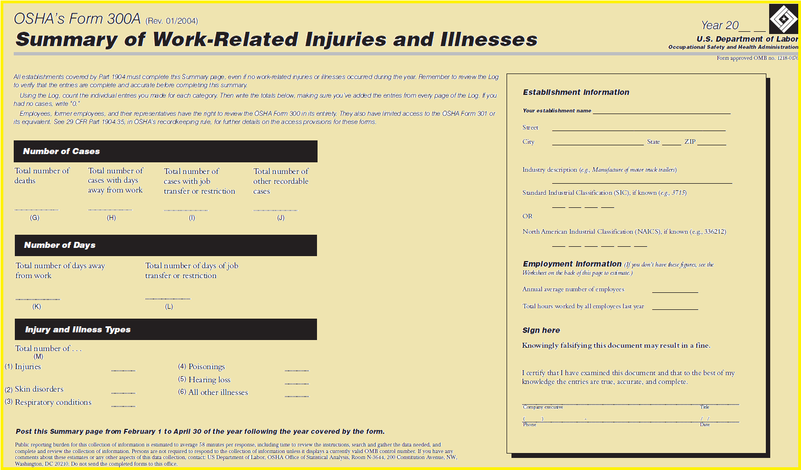
Not Collected Collected Public Access Collected No Public Access

Slide 26
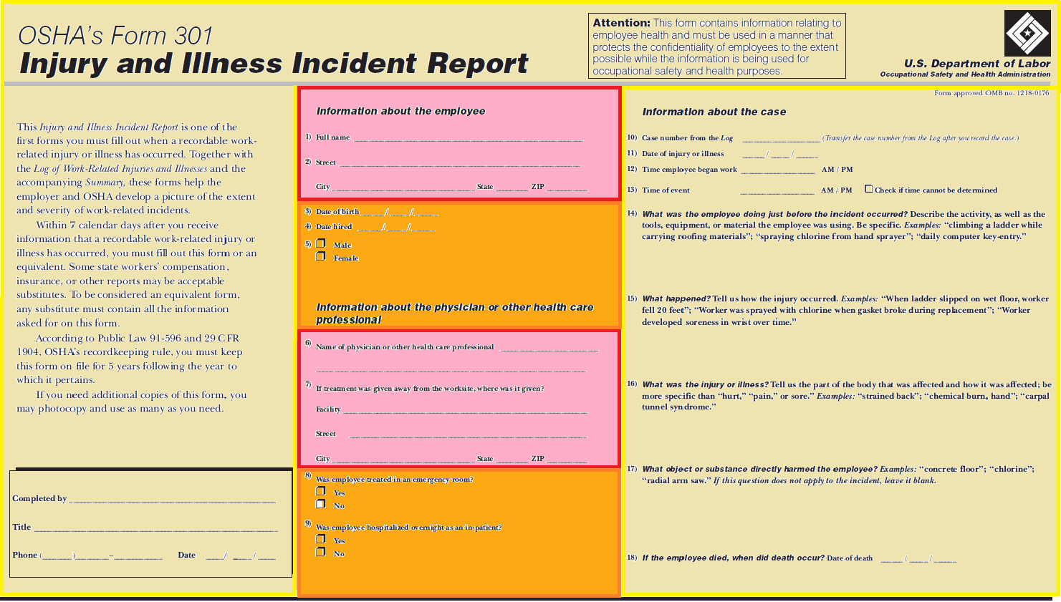
Unknown at This Time
Not Collected Collected Public Access Collected No Public Access

Slide 27
Will Data Need to be Updated
OSHA 300 Logs are updated for five years… However, the system will be designed to allow updates to the electronically submitted Forms but updates will not be required
A contact list will be established of officials to whom requests for corrections should be sent and where and how they may be contacted

Slide 28
What About HIPAA
The Health Insurance Portability and Accountability Act (HIPAA) protects individual privacy rights. The ‘Privacy Rule’ standards protect the privacy of individually identifiable health information (Protected Health Data or ‘PHI’) but is balanced to ensure that appropriate uses and disclosures of PHI still may be made when necessary to treat a patient, to protect he nation’s health, and for other critical purposes. A covered entity may not use or disclose protected health information unless permitted by the Privacy Rule
As required by HIPAA the Privacy Rule only applies to ‘covered entities’

Slide 29
What About HIPAA
A ‘Covered Entity’ includes health plans, health care clearinghouses, and health care providers who conduct certain financial and administrative transactions electronically
OSHA does not fall within the definition of a covered entity for purposes of the Privacy Rule. Therefore, the use and disclosure requirements of the Privacy Rule do not apply to OSHA and do not prevent the Agency from publishing injury and illness recordkeeping information under this final rule

Slide 30
What About HIPAA
The Privacy Rule specifically includes several exemptions for disclosures of health information without individual authorization
164.512(a) of the Privacy Rule permits covered entities to use and disclose PHI without authorization when they are required to do so by another law. HHS has made clear that this disclosure encompasses the full array of binding legal authorities, including statutes, agency orders, regulations, or other federal, state or local governmental actions having the effect of law. As a result, the Privacy Rule does not allow a covered entity to restrict or refuse to disclose PHI required by an OSHA standard or regulation

Slide 31
What About HIPAA
A covered entity may also disclose PHI without individual authorization to ‘public health authorities’ and health oversight agencies’. The preamble to the Privacy Rule specifically mentions OSHA as an example of both
The Privacy Rule permits a covered entity who is a member of the employer’s workforce, or provides health care at the employers request, to disclose to employers protected health information concerning work-related injuries or illnesses or work-related medical surveillance in situations where the employer has a duty under the OSH Act, the Mine Act, or similar state law to keep records on or act on such information

Slide 32
What About HIPAA
Section 164.512(b)(1)(v)(C) specifically permits a covered entity to use or disclose protected health information if the employer needs such information in order to comply with obligations under 29 CFR parts 1904 through 1928

Slide 33
What About ADA
The ADA requires confidentiality for information obtained from medical examinations given to prospective employees and from medical examinations given as part of a voluntary employee health program
OSHA injury and illness records are not derived from pre-employment or voluntary health programs
EEOC recognizes a partial exemption to the ADA strict confidentiality requirements for medical information regarding occupational injury or workers’ compensation claim

Slide 34
What About ADA
The ADA recognizes the primacy of federal safety and health regulations; therefore such regulations, including mandatory OSHA recordkeeping requirements pose no conflict with the ADA
The EEOC Technical Assistance Manual says that ‘ADA does not override health and safety requirements established under other Federal laws… For example.. Employers must conform to health and safety requirements of the U.S. Occupational Safety and Health Administration (OSHA)
Hence OSHA does not believe the submission and publication requirements in 1904.41 do not conflict with the confidentiality provisions of the ADA
There’s a more information on HIPPA and ADA on pages 163-168 of the FR

Slide 35
What about Alternative Forms
Employers will have two options for submitting recordkeeping data to OSHA’s secure Web site
Employers can directly enter data in a web form or…
Employers will be provided with a means of electronically transmitting the information, including information from equivalent forms, to OSHA
We don’t know for sure what means will be provided yet. Specifics aren’t specified..

Slide 36
Is it Changing the ‘No Fault’ RK Policy
The recording or reporting of a work-related injury, illness, or fatality does not mean that an employer or an employee was at fault, that an OSHA rule has been violated, or that the employee is eligible for workers’ compensation or other benefits
The purpose is to collect useful, assessable, establishment specific injury and illness data to better identify and correct workplace hazards
OSHA will use a neutral administrative plan when targeting employers for on-site inspection, similar to the way the Site-Specific Targeting program was administered

Slide 37
What about State-Plan States
State-Plan States must adopt requirements identical to those in 29 CFR 1904.41 in their recordkeeping and reporting regulations as enforceable State requirements within six months after publication of the final rule

Slide 38
Accuracy of Records
One goal of the final rule is to ensure completeness and accuracy of injury and illness data collected by employers and reported to OSHA. To promote completeness and accuracy three provisions were included:
Requiring employers to inform employees of their right to report work-related injuries and illnesses free from retaliation
Employer’s procedure for reporting work-related injuries and illnesses must be reasonable and not discourage employees from reporting
Prohibiting employers from retaliating against employees for reporting work-related injuries and illnesses consisting with the existing prohibition in section 11(c) of the OSH Act

Slide 39
Accuracy of Records
An additional mechanism for OSHA to enforce the existing statutory prohibition on employer retaliation against employees was also added

Slide 40
Providing Reporting Information to Employees
The final rule strengthens 1904.35 by expanding the previous requirement for employers to inform employees ‘how’ to report work-related injuries and illnesses so that now it includes a mandate to inform employees that they have a right to report work-related injuries and illnesses free from retaliation by their employers
The obligation may be met by posting the OSHA Job Safety and Health – It’s The Law worker rights poster from April 2015 or later

Slide 41
Reasonable Reporting Procedures
The final rule amends 1904.35 to state explicitly that employer procedures for employee reporting of work-related illness and injuries must be reasonable. Previously it required employers to set up a way for employees to report work-related injuries and illnesses promptly
Reporting procedures must be reasonable and a procedure that would deter or discourage reporting is not reasonable
Too many steps to do so…
Employer reporting requirements must account for injuries and illnesses that build up over time, have latency periods, or do not appear serious enough to be recordable

Slide 42
Reasonable Reporting Procedures
For example a worker reported shoulder and neck pain that had developed gradually due to work-related repetitive motions beginning one week earlier, Although no single incident precipitated the injury, the worker received a ‘final warning’ for failure to ‘timely report an injury’
This policy was not reasonable because it did not allow for reporting within a reasonable time after the employee realized that they had suffered a work-related injury
For a reporting procedure to be reasonable and not unduly burdensome, it must allow for reporting of work-related injuries and illnesses within a reasonable timeframe after the employee has realized that they have suffered a work-related injury or illness

Slide 43
Reasonable Reporting Procedures
The employer must establish a ‘reasonable’ procedure for employees to report work-related injuries and illnesses and that a reporting procedure is not reasonable if it would deter or discourage a reasonable employee from reporting
The requirement is a performance requirement rather than prescribing specific procedures employers must establish, and therefore gives employers flexibility to tailor their programs to the needs of their workplaces

Slide 44
Prohibiting Discrimination for Reporting
The rule incorporates explicitly the existing prohibition on retaliating against employees for reporting work-related injures and illnesses that is already imposed under 11 (c) of the OSH Act
It doesn’t change the substantive obligations of the employer, rather it provides OSHA an enhanced enforcement tool for ensuring the accuracy of injury and illness logs not dependent on employees filing complaints
The final rule allows OSHA to issue citations to employers for retaliating against employees for reporting work-related injuries and illnesses and require abatement even if no employee has filed an 11(C) complaint

Slide 45
Prohibiting Discrimination for Reporting
Looking at the Medical Removal Protection (MRP) provisions of the lead standard, if an employer denies MRP benefits in retaliation for an employees exercise of a right under the Act, OSHA can cite the employer and seek benefits as abatement because payment of the benefit is important to vindicate the health interests underlying MRP, Section 11(c) is not an exclusive remedy
The goal of abatement would be to eliminate the source of the retaliation and make whole any employees treated adversely as a result of the retaliation

Slide 46
Prohibiting Discrimination for Reporting
For example, if an employer terminated an employee for reporting a work-related injury or illness a feasible means of abatement would be to reinstate the employee with back pay
Or if an employer retaliates against an employee for reporting a work-related illness or injury by denying a bonus to a group of employees, feasible abatement could include revising the bonus policy to correct its retaliatory effect and providing the bonus retroactively to all employees who would have received it absent the retaliation
An employee can still file an 11(c) complaint within the statutory 30 days period regardless of whether OSHA issued, or will issue a citation
11(c) provides a broader range of relief and punitive damages…

Slide 47
Prohibiting Discrimination for Reporting
Discrimination citable under (b)(1)(iv) could include termination, reduction in pay, reassignment to a less desirable positions, or any other adverse action that ‘could well dissuade’ a reasonable employee from reporting a work-related injury or illness
There are three types of policies that could deter an employee from reporting a work-related injury or illness: Disciplinary Policies, Post-Accident Drug Testing Policies, and Employee Incentive Programs

Slide 48
Disciplinary Policies
It’s the employers responsibility to enforce safety rules but disciplining an employee simply for reporting an injury or illness deters employees from reporting them without improving safety
Actions such as suspension, reassignment, harassment, termination
Under the final rule OSHA can issue citations to employers who discipline workers for reporting injuries and illnesses when no legitimate workplace safety rule has been violated

Slide 49
Disciplinary Policies
Pretextual disciplinary actions e.g. asserting an employee was being disciplined for violating safety rule where the real reason was the employee’s injury or illness report. Situations like:
Reporting employees disciplined more severely than other employees who work the same way
Reporting employees selectively disciplined for violation of vague work rules such as ‘work carefully’ or ‘maintain situational awareness’
Vague work rules are particularly subject to abuse by the employer and would not be considered a legitimate workplace safety rule when used disproportionally to discipline workers who report injury or illness
A legitimate workplace safety rule should require or prohibit specific conduct so it can be applied fairly

Slide 50
Disciplinary Policies
Legitimate work rules may not be applied selectively to discipline workers who report work-related illnesses and injuries but not employees who violate the same rule without reporting a work-related injury or illness
(b)(1)(iv) of the final rule authorizes OSHA to issue citations to employers who engage in pretextual disciplinary actions
The final rule prohibits employers only from taking adverse action against an employee because the employee reported an injury or illness.

Slide 51
Disciplinary Policies
Nothing prohibits an employer from disciplining employees for violating legitimate safety rules even if that employee also was injured as a result of that violation
What is prohibited is retaliatory adverse action taken against an employee simply because they reported a work-related injury or illness

Slide 52
Post Incident Drug Testing
If an injury or illness is very unlikely to have caused by employee drug use or if the method of drug testing doesn’t identify impairment but only use at some point in the recent past, requiring the employee to be drug tested may inappropriately deter reporting
Even ANSI has recognized the need for drug testing programs to be carefully designed and implemented to ensure employees are not discouraged from effective participation in injury and illness reporting programs

Slide 53
Post Incident Drug Testing
The final rule does not ban drug testing, it does prohibit employers from using drug testing (or the threat of it) as a form of adverse action against employees who report injuries and illnesses
Drug testing policies should limit post-incident testing to situations in which employee drug use is likely to have contributed to the incident and which the drug test can accurately identify impairment caused by drug use

Slide 54
Post Incident Drug Testing
For example, it would likely not be reasonable to drug test an employee who reports a bee sting, a repetitive strain injury, or an injury caused by lack of machine guarding, or a machine or tool malfunction
Likely it only deters reporting without contributing to an understanding of why the injury occurred or contributing to workplace safety
Employers need to specifically suspect drug use before testing but there should be a reasonable possibility that drug use by the reporting employee was a contributing factor to the injury or illness in order to require drug testing
Drug testing designed in a way to be punitive or embarrassing is likely to deter reporting

Slide 55
Post Incident Drug Testing
If an employer conducts drug testing to comply with the requirements of a state or federal law or regulation the employers motive would not be retaliatory and testing would not be prohibited
The OSH Act prohibits OSHA from superseding or affecting workers compensation laws

Slide 56
Incentive Programs
If an incentive program is not structured carefully they have the potential to discourage reporting of work-related injuries and illnesses without improving workplace safety
A 2012 GAO study found that rate-based incentive programs which reward workers for achieving low rates of reported injury and illnesses may discourage reporting while more positive incentive programs which reward workers for activities like recommending safety improvements did not have the same effect

Slide 57
Incentive Programs
ANSI/AIHA Z10-2012 indicates that incentive programs… should be carefully designed and implemented to ensure employees are not discouraged from effective participation in injury and illness reporting programs
OSHA previously recognized incentive programs that discourage employees from reporting injuries and illnesses by denying a benefit to employees who report an injury or illness may be prohibited by 11 (c)
To the extent incentive programs cause under-reporting they can result in under-recording of injuries and illnesses which is what is addressed by the final rule’s prohibition on using incentive programs in a way that impairs accurate recordkeeping

Slide 58
Incentive Programs
It is a violation of (b)(1)(iv) to take adverse action against an employee for reporting a work-related injury or illness whether or not the adverse action was part of an incentive program so it would be a violation for an employer to use an incentive program to take adverse action including denying a benefit, because an employee reports a work related injury or illness such as disqualifying the employee for a monetary bonus or any other action that would deter a reasonable employee from reporting injuries and illnesses

Slide 59
Incentive Programs
An incentive program makes a reward contingent upon, for example, whether the employee correctly followed legitimate safety rules rather than whether they reported any injuries or illnesses the program would not violate this provision
OSHA encourages incentive programs that promote worker participation in safety related activities such as identifying hazards or participating in investigations of injuries, incidents, or near misses
Modest rewards for suggestions to strengthen safety and health, throwing a recognition party at the successful completion of company-wide training…
Revised VPP Policy Memo #5 suggestions…

Slide 60
An Odd Fact I Learned
There are two types of rules: Standards and Regulations
Standards specify remedial measures to be taken to prevent and control employee exposure to identified occupational hazards e.g. 1910.95 is a standard because it includes remedial measures to address the specific identified hazard of employee exposure to occupational noise…
Regulations are the means to effectuate other statutory purposes such as collection and dissemination of records of occupational injuries and illnesses e.g. an administrative effort to designed to uncover violations of the Act and discover unknown dangers
Standards aim to correct particular identified workplace hazards while regulations further the general enforcement and detection purposes of the OSH Act

Slide 61
Interesting Links
Its not a product endorsement and you need to verify what your State’s current law is. But its interesting to look at:
http://www.ohsinc.com/info/state-drug-testing-laws/

Slide 62
Questions?
Houston North Area Office
Joann Figueroa, Area Director
Jim Shelton, CAS
690 S. Loop 336 W., Suite 400
Conroe, TX 77304
shelton.james@dol.gov
Keep up to date with the Houston North Area Office email list. Contact Jim Shelton at the above email

Slide 63
Disclaimer
This information has been developed by an OSHA Compliance Assistance Specialist and is intended to assist employers, workers, and others as they strive to improve workplace health and safety. While we attempt to thoroughly address specific topics [or hazards], it is not possible to include discussion of everything necessary to ensure a healthy and safe working environment in a presentation of this nature. Thus, this information must be understood as a tool for addressing workplace hazards, rather than an exhaustive statement of an employer’s legal obligations, which are defined by statute, regulations, and standards. Likewise, to the extent that this information references practices or procedures that may enhance health or safety, but which are not required by a statute, regulation, or standard, it cannot, and does not, create additional legal obligations. Finally, over time, OSHA may modify rules and interpretations in light of new technology, information, or circumstances; to keep apprised of such developments, or to review information on a wide range of occupational safety and health topics, you can visit OSHA’s website at www.osha.gov.

