Slide 1
Why unions matter in construction
August 30, 2016 National VPPPA Conference Orlando FL

Slide 2
Speakers
Dr. Ben Amick
Dept Chair, Health Policy & Prevention, Florida International University, Miami FL
Senior Scientist, Institute for Worker & Health, Toronto, Ontario, Canada
Katherine Jacobs
Director of Research, Ontario Construction Secretariat, Toronto, Ontario, Canada
Cindy Lewis, MSPH, ASP
Director, Gulf Coast Safety Institute, College of the Mainland, Texas City TX
OSHA Challenge Administrator

Slide 3
Why are you here?

Slide 4
Why does Canadian research apply to US?
The types of trade unions are the same – electrical, steel workers, millwrights, laborers.
Joint Health & Safety Committees mandated by legislation for companies with >20 employees (in Ontario)

Slide 5
What We Wanted to Know ….
“Do union certified employers in the construction industry experience fewer injuries and illnesses compared to non-union employers?”

Slide 6
Research Partners
Representing the:
Building trades unions
Union contractors
Industrial, Commercial and Institutional Construction
Independent, not-for-profit research organization with the goal to promote, protect and improve the safety and health of working people by conducting actionable research

Slide 7
Why Our Collaboration is Important?
Limited research and evidence
Construction can be a high hazard industry
Lack of Data
Notes:
The role of unions in supporting OHS remains understudied, especially in Canada and in Construction
The WSIB has not consistently captured union status in their data
Good news, the new form 7 contains a mandatory union status field
Construction is a high hazard industry
OCS has the best available list of union-certified construction firms in Ontario

Slide 8
Research Sample 2006-2012

Slide 9
Building our Sample
INITIAL SAMPLE
Non-Union Union
61,083 6,380
(90.5%) (9.5%)
EXCLUDE Firms
with Total FTEs <= 1
Non-Union Union
22,457 583
FINAL SAMPLE
Non-Union Union
38,626 5,797
(811,146 FTEs) (718,828 FTEs)

Slide 10
Statistical Analyses
Injury & Illness rates in union firms compared to non-union firms to determine a union safety effect
Adjusted for other conditions that may explain union effect:
The WSIB Classification Units (CUs) to control for occupation related hazards
The firm location in Ontario to control for safety culture variation across the province
Work place size and complexity to control for variability in H&S practices

Slide 11
IWH Findings – A Union Safety Effect
Higher Frequency of NLT Claims
13% higher Total Claims 28% higher No Lost-time Claims
Lower Frequency & Severity
14% less Lost-time Claims 8% less MSDs
29% less Critical Injuries *
* Caution Should Be Made in Interpreting the Critical Injury Estimate

Slide 12
What About …
Differences are due to larger firms being unionized and having more resources
Yes, but even after we adjusted for this we still observed the union safety effect
The sample is a selective sample of unionized construction firms
No, we included all trades working in the ICI sector
Union effect is only in some trades or trades around Toronto
No, the patterns are consistent across WSIB Classification Units

Slide 13
Why?
Time for your feedback

Slide 14
What Explains the Union Safety Effect?
Union education and training programs are more effective in creating safe behaviors
$40 million annually is invested in specialized apprenticeship, upgrade and safety training for union tradespeople
Over 95 state-of-the-art union/employer training centers in every region of the province ensuring union tradespeople have the skills required for productive and safe worksites
1.7 million man-hours of training creates a highly-skilled, safety-focused workforce

Slide 15
What Explains the Union Safety Effect?
Well-established reporting practices
Union supervisors and stewards require the reporting of all incidents including near misses
Programs and practices that more effectively identify and reduce construction work hazards
Toolbox talks
Full-time healthy & safety worker co-chair on larger projects
Union workers have a greater voice to report without fear of reprisal

Slide 16
NEW Results by VPP Element

Slide 17
Management Leadership
What We Asked
What We Found
1. Top management is actively involved in the safety program.
2. The safety manager (or, the person in charge of health & safety) receives support from top management.
3. Your company spends time and money on improving safety performance.
4. Your company considers safety to be equally important as production and quality in the way work is done.
5. Your company analyzes injury and illness data (e.g., claims data, first aid logs) to identify causes and target solutions.
6. The safety program or committee has the responsibility, authority and resources to identify and address safety problems.
No Differences Between Union and Non-Union Construction Firms

Slide 18
Employee Involvement - Engagement
What We Asked
What We Found
1. Employees are involved in decisions affecting their daily work.
2. Working relationships are cooperative.
3. There is a high level of trust in the employee/employer relationship at your company.
4. Communication is open and employees feel free to voice concerns and make suggestions.
No Differences Between Union and Non-Union Construction Firms

Slide 19
Employee Involvement - JHSC practices
What We Asked
What We Found
1. Your JHSC or H&S representative participates in hazard recognition activities.
2. Your JHSC or H&S representative provides input to Tool Box talks.
3. Your JHSC or H&S representative participates in investigations related to accidents, near misses, and illnesses.
4. Your JHSC or H&S representative prepares AND posts meeting minutes.
Significant Differences Between Union and Non-Union Construction Firms
Union Firms Better Performers

Slide 20
Worksite analysis – Ergonomic Policies & Practices
What We Asked
What We Found
1. Jobs are designed to reduce heavy lifting.
2. Jobs are designed to reduce repetitive movement.
3. Ergonomic strategies are used to improve workstation design.
4. Ergonomic factors are considered in purchasing new tools, equipment, or furniture.
No Differences Between Union and Non-Union Construction Firms

Slide 21
Hazard Prevention & Control
What We Asked
What We Found
1. Health and safety incidents are investigated for root causes.
2. An analysis of the hazards for each jobsite is performed.
3. Engineering controls are used for all applicable hazards (e.g., special tools, equipment).
4. Safety and health rules and work practices are fully operational.
5. Your company is fully prepared to deal with all emergency situations it may encounter (e.g., robbery, fire, or tornado).
6. Your company documents progress in correcting jobsite hazards.
7. Hazards are re-assessed during the project as tasks change.
8. Near-miss incidents are reported in a timely manner.
9. Actions are taken to prevent future incidents.
Significant Differences Between Union and Non-Union Construction Firms
Union Firms Better Performers

Slide 22
Safety & Health training
What We Asked
What We Found
1. Training to perform work duties with known hazards.
2. OHS awareness training (toolbox talks, job analysis.
3. Supervisors trained in legal responsibilities to protect worker health and safety
4. Workers trained in rights to refuse to under OSHAct
5. Employees receive standard training (first aid, fall arrest)
6. Employees receive site or trade specific training
7. Employees receive training in leadership or basic human resource skills.
8. Employees receive training in hazard recognition, control and reporting.
Significant Differences Between Union and Non-Union Construction Firms
Union Firms Better Performers
Notes:
Explore the relationship between organizational policies and practices and claims and whether there is an interaction between union status and policies and practices in predicting claims.

Slide 23
Does this make sense?
How can we use this information?

Slide 24
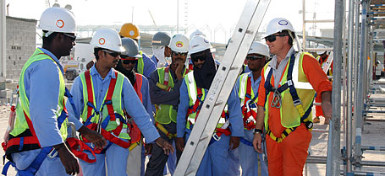
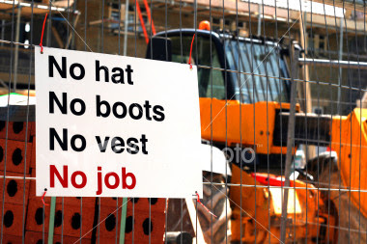
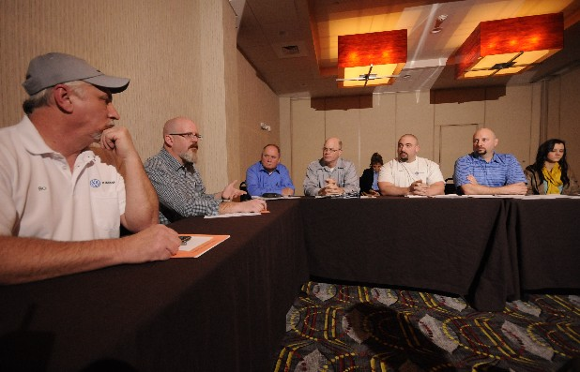
Unions Can Make A Difference
Notes:
Training
OPPs
Worker Voice both inside the company but also in the province
Injury reporting

Slide 25
Thank You!
Dr. Ben Amick
bamickii@fiu.edu, 305-348-7527
Katherine Jacobs
kjacobs@iciconstruction.com. 416-620-5210
Cindy Lewis, MSPH, ASP
Clewis1@com.edu, 409-933-8495
Presentation can be found at www.com.edu/gcsi

